Slide 1
BackPropagation

Slide 2
Introduction
Artificial Neural Networks are crude attempts to model the highly massive parallel and distributed processing we believe takes place in the brain.
Back propagation, an abbreviation for "backward propagation of errors", is a common method of training artificial neural networks used in conjunction with an optimization method such as gradient descent.
The method calculates the gradient of a loss function with respect to all the weights in the network.
The gradient is fed to the optimization method which in turn uses it to update the weights, in an attempt to minimize the loss function.

Slide 3
Back propagation Algorithm
The back propagation learning algorithm can be divided into two phases:
Phase 1: Propagation
  Forward propagation of a training pattern's input through the neural network in order to generate the propagation's output activations.
  Backward propagation of the propagation's output activations through the neural network using the training pattern target in order to generate the deltas (the difference between the input and output values) of all output and hidden neurons.
Phase 2: Weight update
  Multiply its output delta and input activation to get the gradient of the weight.
  Subtract a ratio (percentage) of the gradient from the weight.

Slide 4
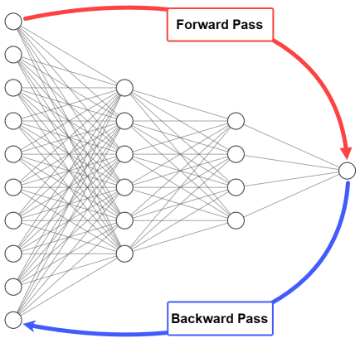

Slide 5
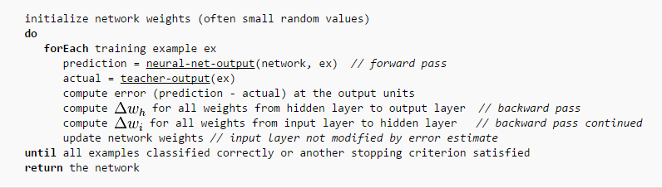
Back propagation Algorithm

Slide 6
Gradient descent algorithm
Back propagation calculates the gradient of the error of the network regarding the network's modifiable weights.
This gradient is almost always used in a simple stochastic gradient descent algorithm to find weights that minimize the error.

Slide 7
Propagating forward
Given example X, compute the output of every node until we reach the output nodes:
Output nodes
Compute sigmoid function
Internal nodes
Input nodes
Example X

Slide 8
Propagating Error Backward
For each output node k compute the error:
δ_{k} = O_{k} (1-O_{k})(t_{k} – O_{k})
For each hidden unit h, calculate the error:
δ_{h} = O_{h} (1-O_{h}) Σ_{k} W_{kh} δ_{k}
Update each network weight:
W_{ji} = W_{ji} + Δw_{ji}
where Δw_{ji} = η δ_{j} O_{i} (W_{ji} - weight of node i to node j)

Slide 9
Number of Hidden Units
The number of hidden units is related to the complexity of the decision boundary.
If examples are easy to discriminate few nodes would be enough. Conversely complex problems require many internal nodes.
A rule of thumb is to choose roughly m / 10 weights, where m is the number of training examples.
Learning Rates
Different learning rates affect the performance of a neural network significantly.
Optimal Learning Rate:
  Leads to the error minimum in one learning step.

Slide 10
Limitations of the back propagation algorithm
It is not guaranteed to find global minimum of the error function. It may get trapped in a local minima,
  Improvements,
    Add momentum.
    Use stochastic gradient descent.
    Use different networks with different initial values for the weights.
Back propagation learning does not require normalization of input vectors; however, normalization could improve performance.
  Standardize all features previous to training.

